Slide 1
ACT – Asset Compliance Tracker Overview

Slide 2
Objectives:
ACT Overview
Accessing & Navigating ACT
Platform / OS Teams
DevOps / Application Teams
Node Search
Reporting
Scorecards
Notifications

Slide 3
ACT!Now
ACT! is a web-based tool used to house information for build specifications and port usage as well as measure compliance to those specifications
Platform teams enter Operating System specifications
Application Teams enter Application specifications including selecting the associated OS specification
Chef Compliance provides reporting for the adherence to the specifications
Email notifications notify Owners of unassigned servers and compliance failures

Slide 4
Navigating ACT

Slide 5
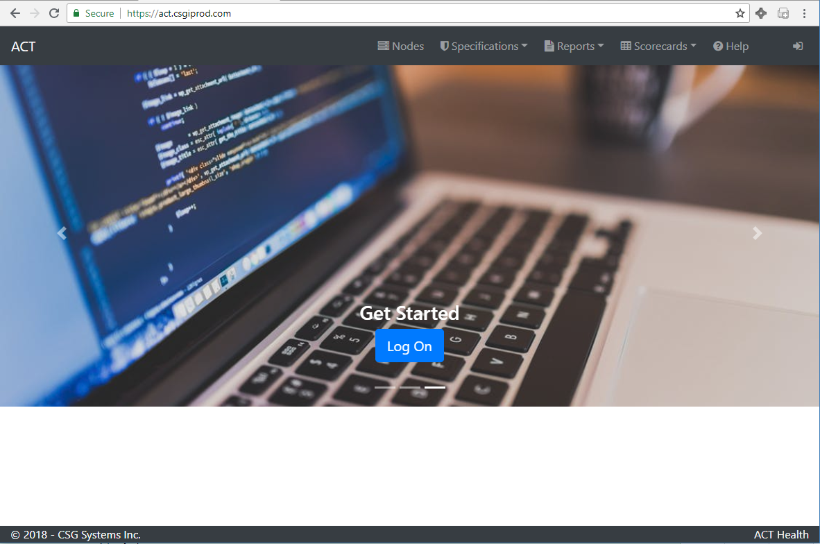
Accessing ACT
ACT home page appears

Slide 6
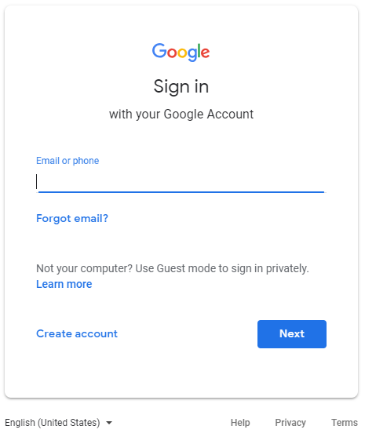
Accessing ACT
This will be managed by your company’s infrastructure team to provide single sign on to access the tool

Slide 7
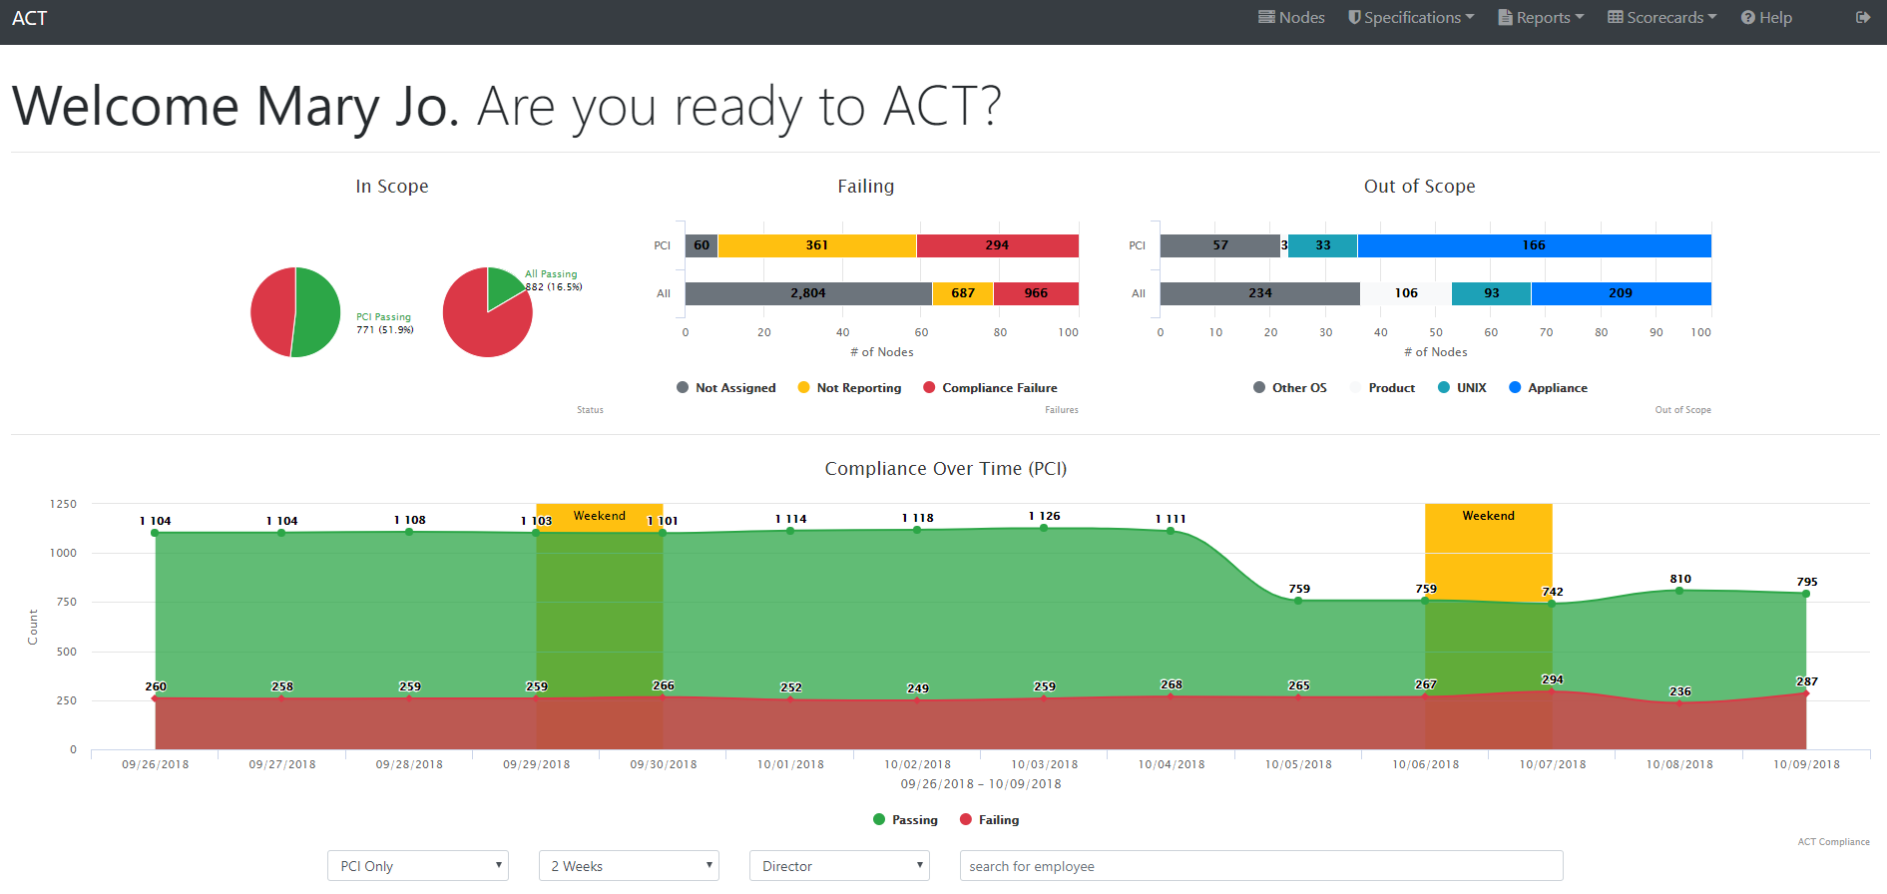
Accessing ACT
Home page Dashboard includes the following areas:
Graphing by In Scope, Failing status values, Out of Scope values
Compliance Over Time for PCI categorized servers
Director Score for PCI categorized server status values
Top Offenders within the last 24 Hours (PCI)
Operating System Specification Spread
Product – Function Application Specification Spread

Slide 8
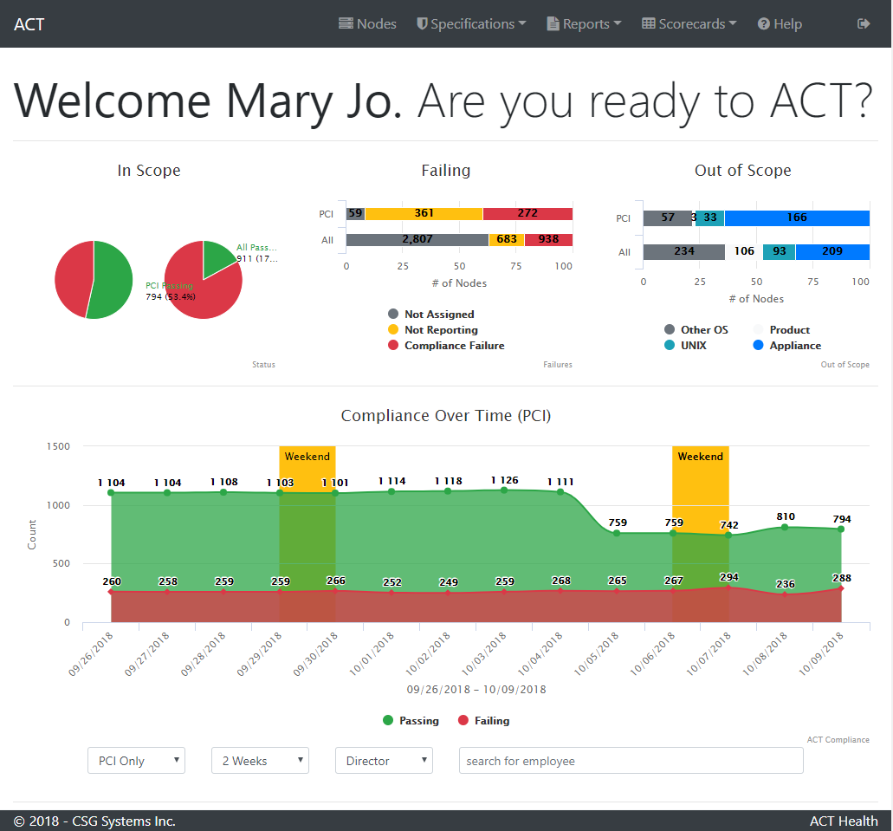
Dashboard
In Scope, Failing and Out of Scope
In Scope illustrates the current Passing percentage for servers categorized as PCI and another for all Nodes/Servers
Failing illustrates the number of Nodes/ Servers that are not passing the compliance process
Out of Scope illustrates the number of Nodes/ Servers that do not run the compliance process

Slide 9
Dashboard
Compliance Over Time (PCI)
Illustrates the number of passing vs. failing servers over a 2 week period (default view)
Users can adjust the time period to reflect data from 1 to 4 weeks and if they want to see PCI only or all server classifications
The graph can also be updated to display a single Director or Owner by entering the name in the text box

Slide 10
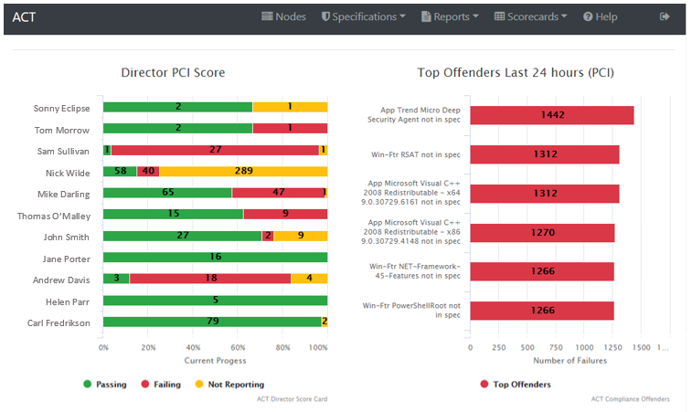
Dashboard
Director PCI Score
Displays the Node/Server counts by Director
Users can click on the graph to be directed to the Node Search screen for the Director selected
Top Offenders Last 24 Hours
Displays a count of all the Nodes/Servers for a specific failure within a 24 hour period

Slide 11
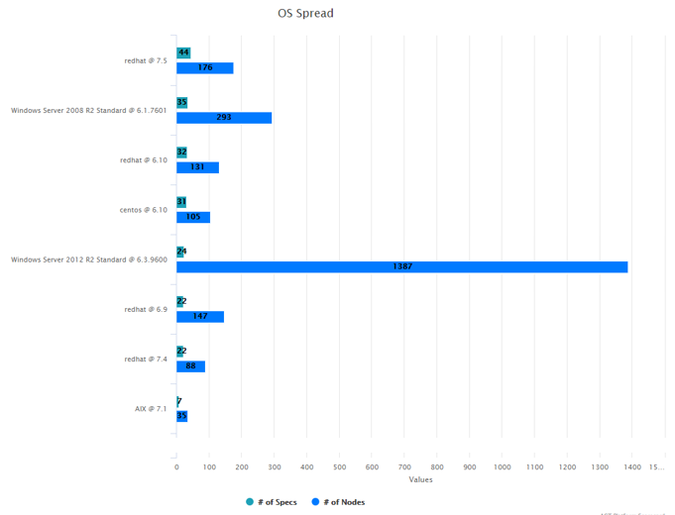
Dashboard
OS Spread
Illustrates the number of Operating System specs for a given OS version and the number of Nodes/Servers that are inheriting the given OS information

Slide 12
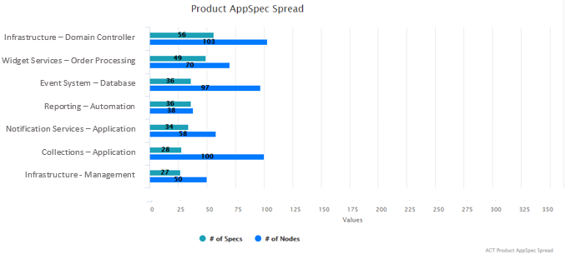
Dashboard
Product AppSpec Spread
Illustrates the number of Application specs for a given Product – Function and the number of Nodes/Servers that are assigned

Slide 13
Navigating in ACT
Menu options include:
Nodes – Search for nodes and assign an Application Spec
Specifications– Search, edit or add an Application or Operating System specifications
Reports – Data organized by specific areas or status
Scorecards – Summarized data by Management Levels
Help – Access additional information, training and FAQs
Log Off

Slide 14
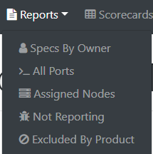
Navigating in ACT
Reports options include:
Specs By Owner
All Ports
Assigned Nodes
Not Reporting
Excluded by Product
Please refer to the Reports section for additional information on the various reports.

Slide 15
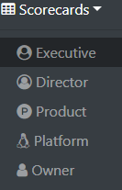
Navigating in ACT
Scorecard options include:
Executive
Director
Product
Platform
Owner Please refer to the Scorecard section for additional information on the options available.

Slide 16
Navigating in ACT
Help options are configurable and includes the following samples however you may enter as many as you would like:
FAQ
Training

Slide 17
Specifications

Slide 18
Specifications
Platform teams enter Operating System specifications
Application Teams enter Application specifications including selecting the associated OS specification
Together they are combined to create the overall Build Specification
The Specification is created using a wizard that consists of 3-4 steps which are very similar for both OS and Application specs.
Teams can perform the following options on both the Platform as well as the Application Spec pages
Add new Specs
Search for a Spec
Edit existing Specs
Clone an existing Spec
Review the Compliance for a specific Spec
View the Port Report for a specific Spec
Delete an Spec

Slide 19
Add New Spec
From either the Platform or Application page, to add a new Spec, click either the “Add OS Spec” or “Add App Spec” button to launch a step by step wizard
The number of steps in the wizard are determined by the Platform selected
Windows has 4 steps (Overview, Features, Applications, Ports)
Linux/Unix has 3 steps (Overview, Packages, Ports)
Other has 2 steps (Overview, Ports)

Slide 20
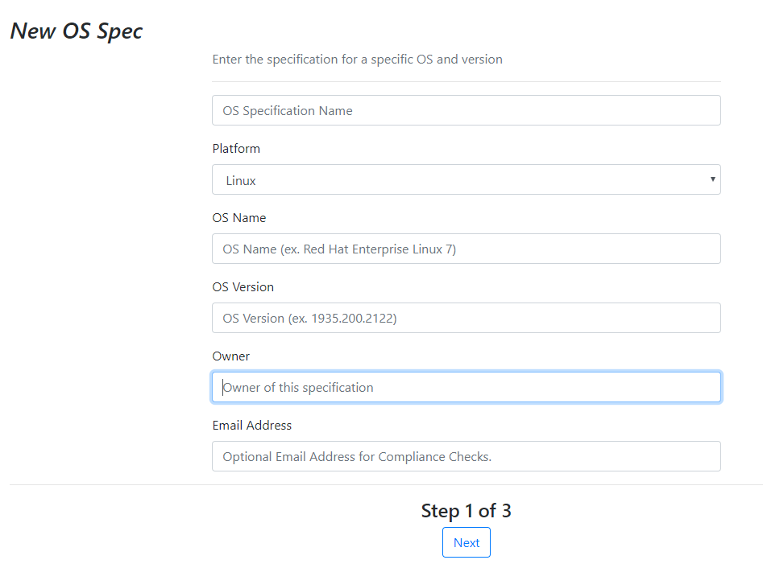
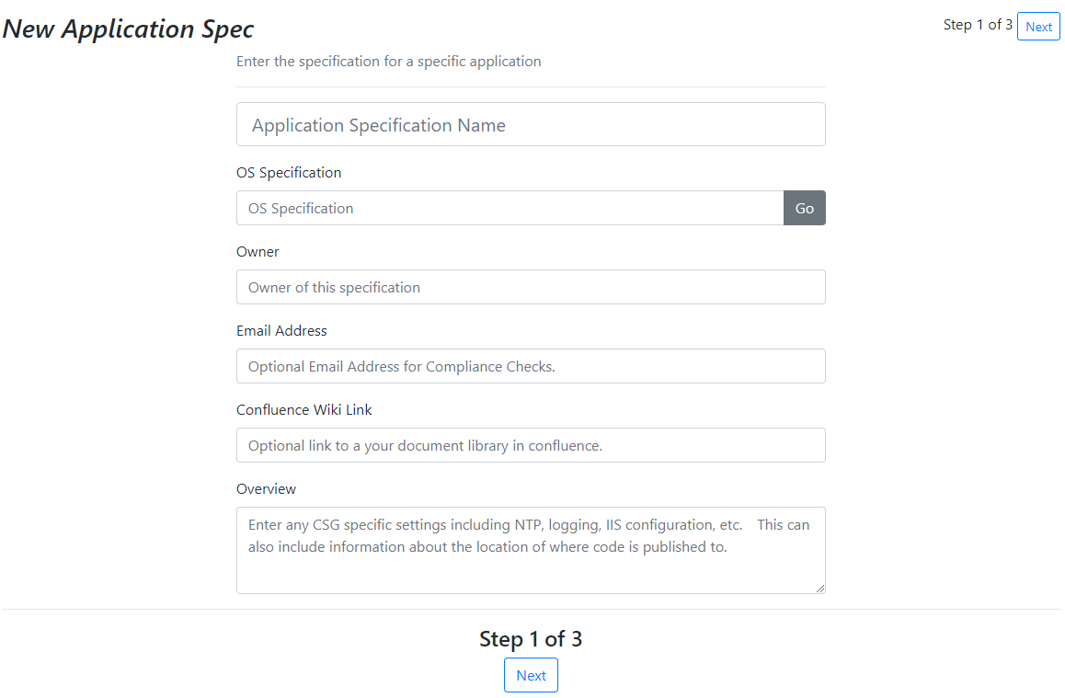
Add new spec – Step 1
Step 1 contains overview details for the spec
The number of steps will be updated once the Platform/OS Specification value is selected
Owner will default to the name of user logged on

Slide 21
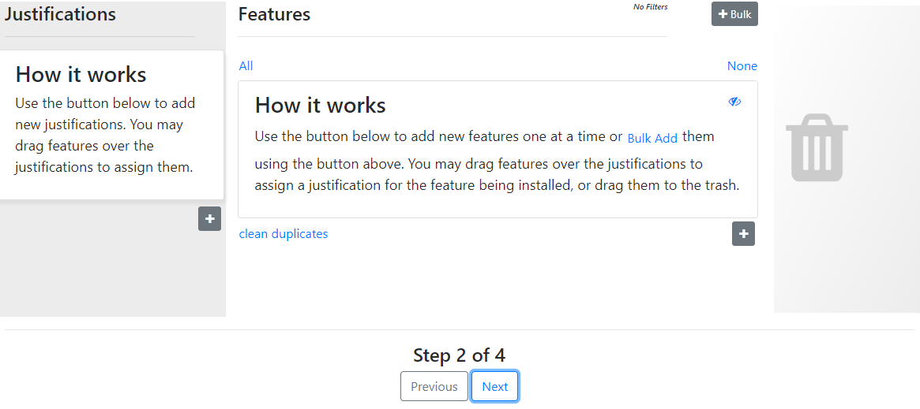
Add new spec – Steps 2/3
Step 2 of the wizard will identify Features for Windows or Packages for Unix/Linux

Slide 22

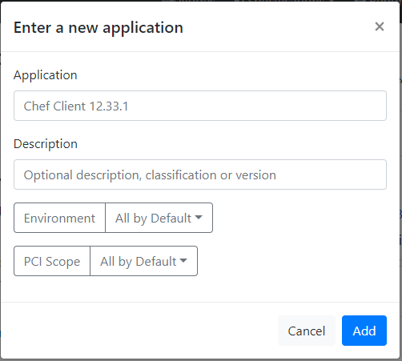
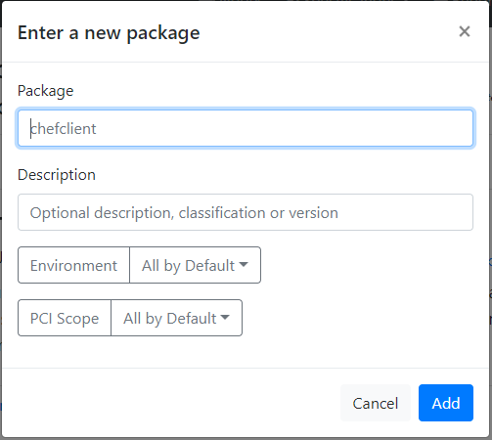
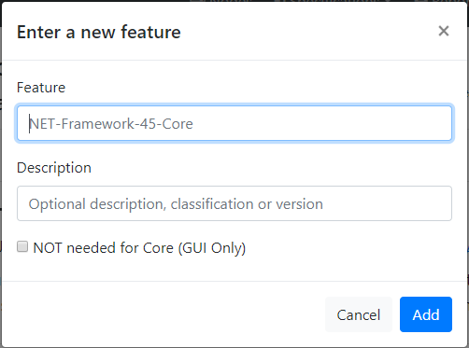
Add new spec – Steps 2/3
Step 2 of the wizard will identify Features for Windows or Packages for Linux/Unix
Step 3 of the wizard will identify Applications for Windows
Single items can be added or edited by clicking the

Slide 23

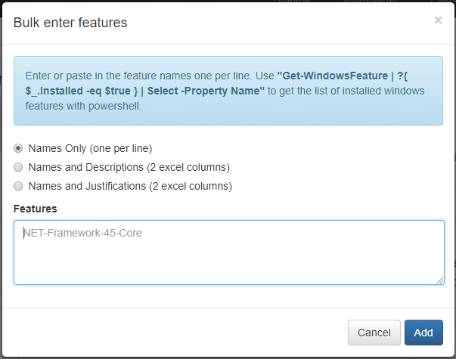
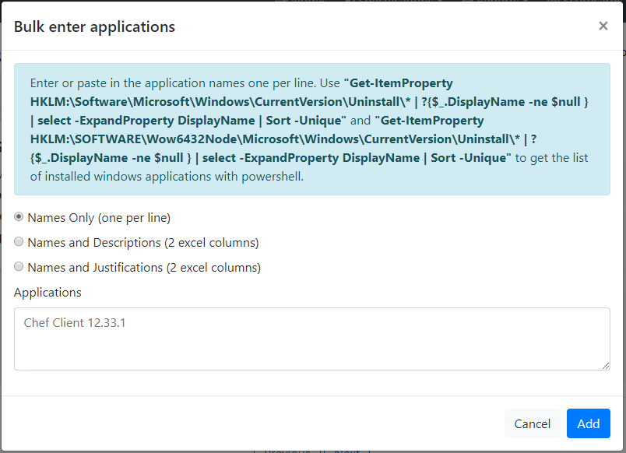
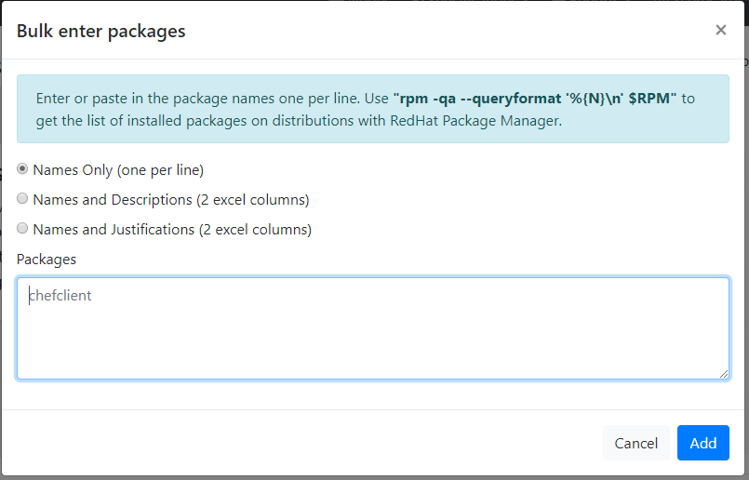
Add new spec – Steps 2/3
Multiple items can be added by clicking the
NOTE: The text in the blue window will update based on the platform selected.
3 options for Bulk entry
Name only – copy paste the results from executing command
Name & Description – use an Excel column format
Name & Justification – use an Excel column format

Slide 24
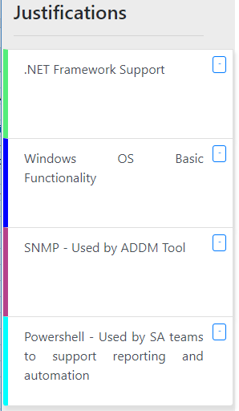
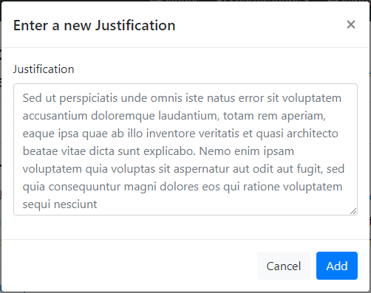
Add new spec – Steps 2/3
Click the in the left-hand column to add a new Justification (the sample text will disappear)
Once added, a color will automatically be assigned to each Justification to easily assign Features, Applications, or Packages

Slide 25
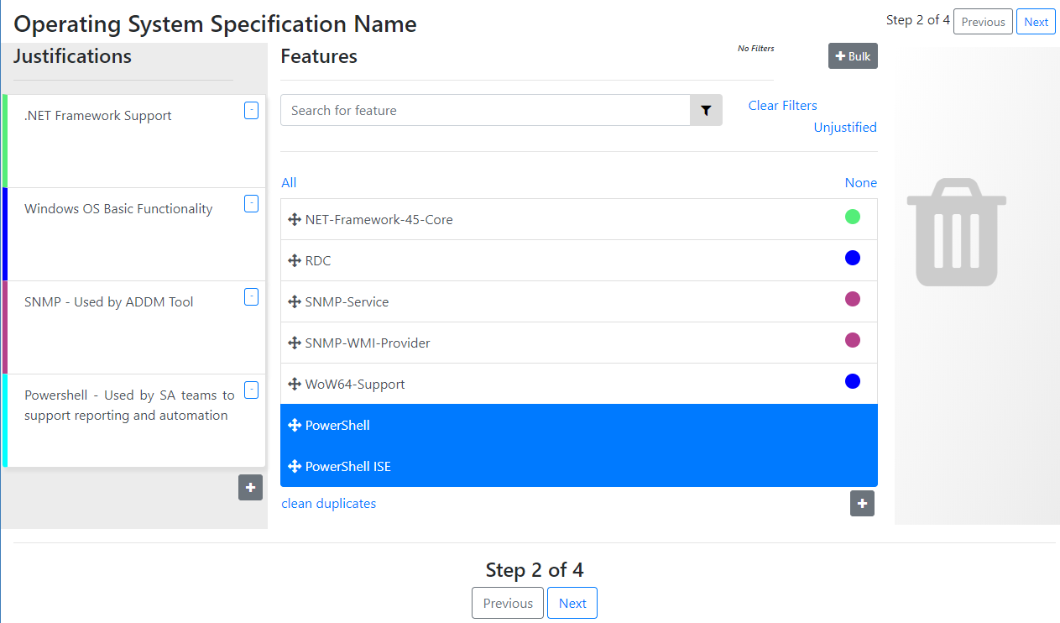
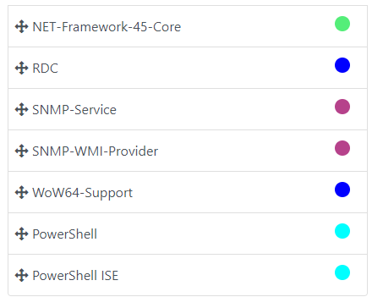
Add new spec – Steps 2/3
To assign an item to a Justification, click on the item or use the control key to select multiple items to highlight, then drag it to the justification entry to assign.
Once assigned, the color associated to the justification will appear next to the item
Likewise, an item can be selected and dragged to the trash can to remove it from the list.

Slide 26
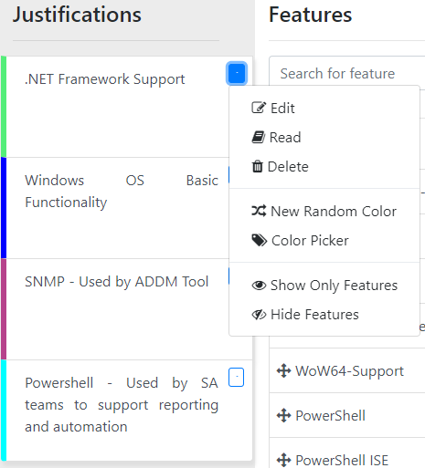
Add new spec – Steps 2/3
Click on the down arrow next to the Justification text to display the actions available
Edit – update the text
Read – displays longer text
Delete – removes the justification
New Random Color – automatically assigns a new color to the justification
Color Picker – allows you to select the color assignment
Show Only Features – filters the items assigned to this selected justification
Hide Features – filters the items to remove the selected justification from the list
Additional filter options include searching for specific text within the list of items or to view only Unjustified items

Slide 27
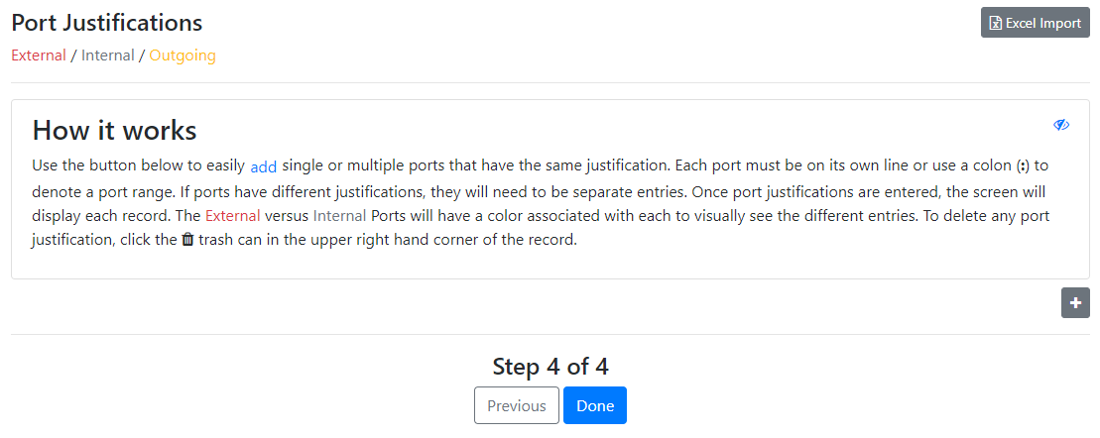
Add new spec – Final step
The last step in the wizard is the Port Justifications

Slide 28
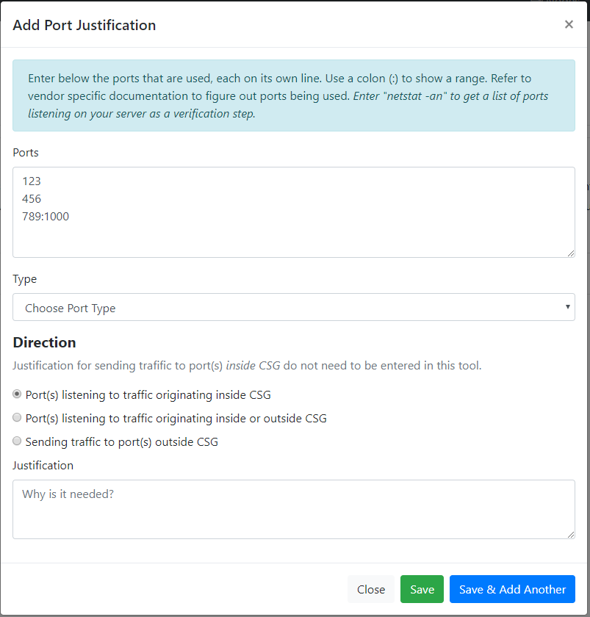
Add new spec – Final step
To add a single entry, click on the
Ports with the same justification reason can be entered with each port on separate lines
Use a colon to indicate a range of ports

Slide 29
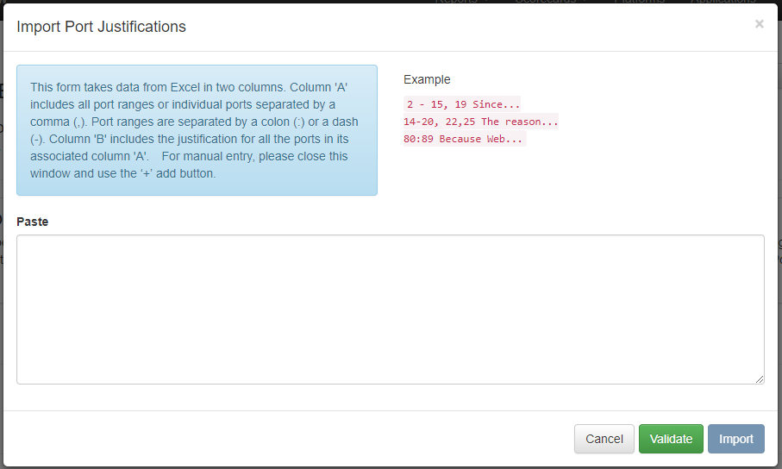
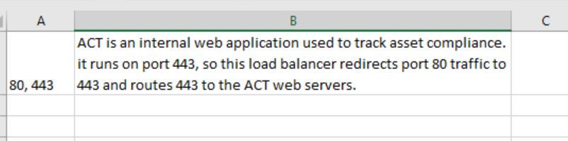
Add new spec – Final step
To add multiple entries, click on the Excel Import
Within Excel, using Columns A and B, enter the information in a similar format as below and copy/paste into the window.

Slide 30
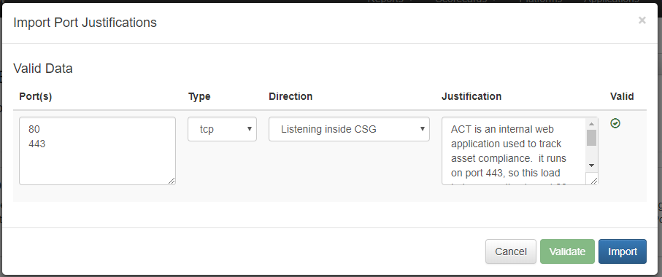
Add new spec – Final step
Click on the Validate button to verify the formatting
Select the Protocol Type and Direction
Verify the Ports and Justification
Click Import to add the information to ACT

Slide 31
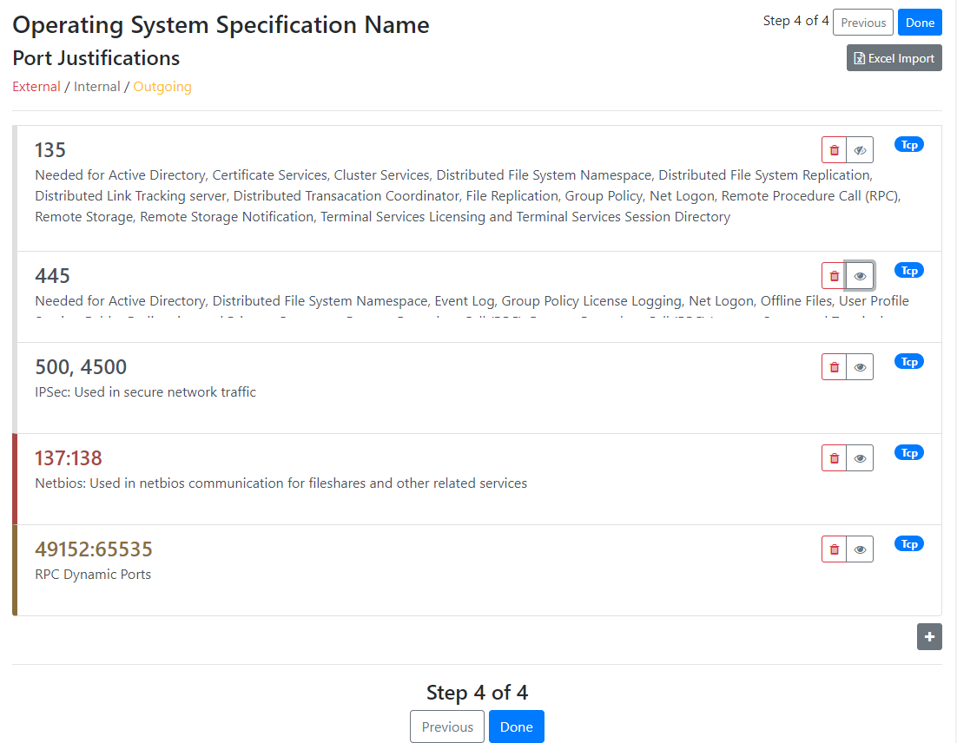
Add new spec – Final step
Ports flagged as Internal will have a grey side bar
Ports flagged as External will have a burgundy side bar
Ports flagged as Outgoing will have a gold side bar

Slide 32
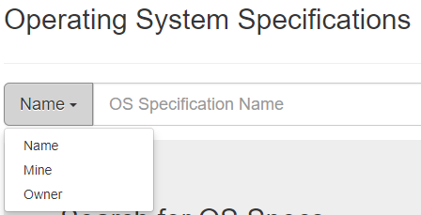
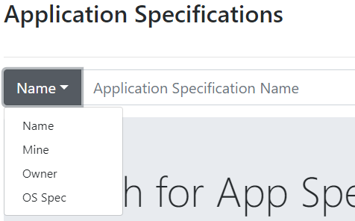
Search
The following search options are available:
Specification Name
Mine
Owner
OS Spec (applies only to the Application Specs page)

Slide 33







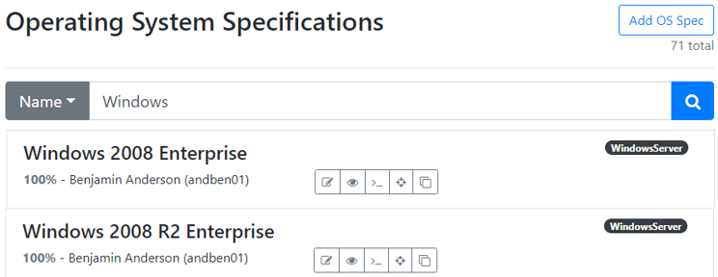
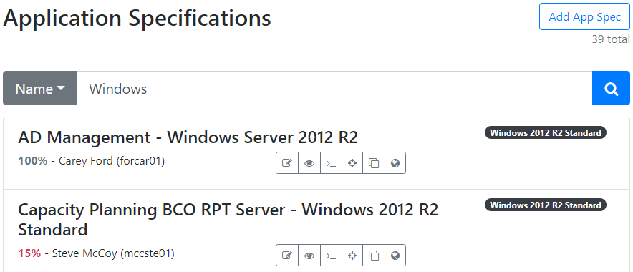
- Search
Search results display with an option to:
Edit - initiates the step by step wizard
View Report – displays the Build Spec Report
View Port Report – displays the Port information
Review Compliance – displays the aggregate Chef results
Clone - creates a copy of the selected spec; you will be prompted to confirm this action
Delete Spec – if you are the owner of the Spec you may delete it; you will be prompted to confirm this action
Assign Nodes (App Spec Search only) – displays server information to easily assign them to the selected App spec
Example when searching by spec Name of “Windows”
Notes:
Remove extra period

Slide 34
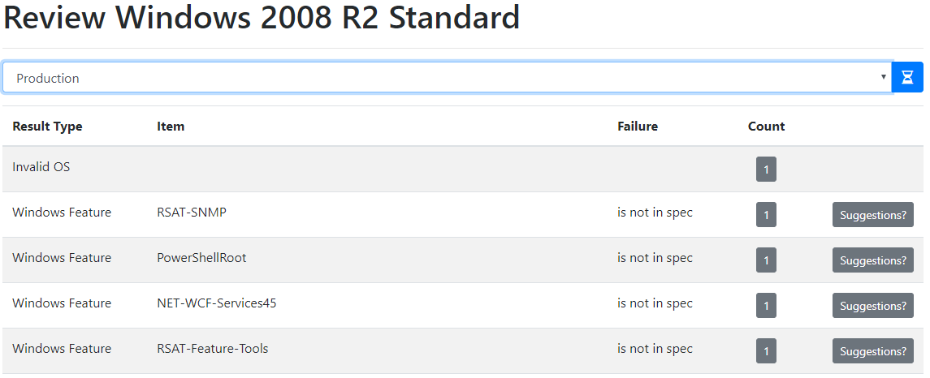
Compliance Review
The Compliance Review gathers and displays data from Chef for Nodes associated to the Specification for a given environment.
After selecting the environment, click the button to refresh the data displayed.

Slide 35
Compliance Review
Windows Features and Applications or Linux Packages as well as the Port information will be gathered.
If an item “is not in spec” that means that it was discovered on the Node but it is not part of the Spec.
If an item “is not installed” that means that it was included in the Spec, but was not discovered on the Node.
The Count button displays the number of Nodes with this failure and you can click on it to display the Node name(s).
The Suggestions button provides advise on how to resolve the failure.
Chef updates every 30 minutes, so after a failure has been resolved, it can be validated by refreshing the screen after 30 minutes.

Slide 36

Compliance Review
Suggestions:
If an item “is not in spec” the following options will be presented to the user:
Edit the AppSpec {name of App Spec} owned by {App Spec Owner name} and add the feature/application/package {name of item}
Clone the AppSpec {name of App Spec} owned by {App Spec Owner name} and add the feature/application/package {name of item} then change the failing nodes to point to the clone.
Edit the OSSpec {name of OS Spec} owned by {OS Spec Owner name} and add the feature/application/package {name of item}
Clone the AppSpec {name of App Spec} owned by {OS Spec Owner name} and add the feature/application/package {name of item} then change the failing nodes to point to the clone.
Remediate the issue on the nodes, themselves.
By clicking the “Add it” button, it will automatically add the item to the Application Spec with “added by fix-it-for-me” displaying in the Details area. The user will need to edit the spec and associate that newly added item to a justification.

Slide 37

Compliance Review
Suggestions:
If an item “is not installed” the following options will be presented to the user:
Edit the AppSpec {name of App Spec} owned by {App Spec Owner name} and remove the feature/application/package {name of item}
Clone the AppSpec {name of App Spec} owned by {App Spec Owner name} and add the feature/application/package {name of item} then change the failing nodes to point to the clone.
Remediate the issue on the nodes, themselves.
By clicking the “Remove it” button, it will automatically delete the item to the Application Spec.

Slide 38
Compliance Review
Suggestions for Ports:
If a Port “is not in spec” the following options will be presented to the user:
Edit the AppSpec {name of App Spec} owned by {App Spec Owner name} and add the port {port number}
Clone the AppSpec {name of App Spec} owned by {App Spec Owner name} and add the port {port number} then change the failing nodes to point to the clone.
Edit the OSSpec {name of OS Spec} owned by {OS Spec Owner name} and add the port {port number}
Clone the AppSpec {name of App Spec} owned by {OS Spec Owner name} and add the port {port number} then change the failing nodes to point to the clone.
Remediate the issue on the nodes, themselves.
The “Add it” button will not be available since ports require additional research before adding or removing them to/from a spec.

Slide 39
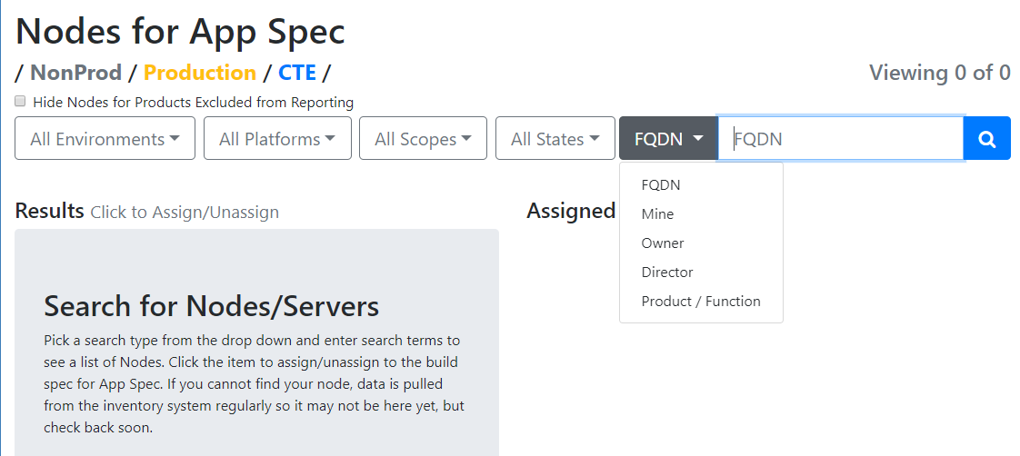
Application – Assign Nodes
The Nodes screen integrates with data from Asset Inventory System
Search options include:

Slide 40
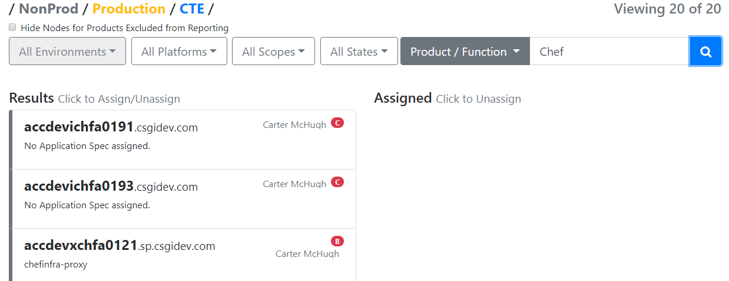
Application – Assign Nodes
Search results will display a color coded side bar
Additional information will display when the mouse hovers over the results
Click on the nodes in the Result list to assign them to the Application Spec
Likewise, to remove one simply click on the highlighted node from either the Results list of the Assigned list

Slide 41
Node Search

Slide 42
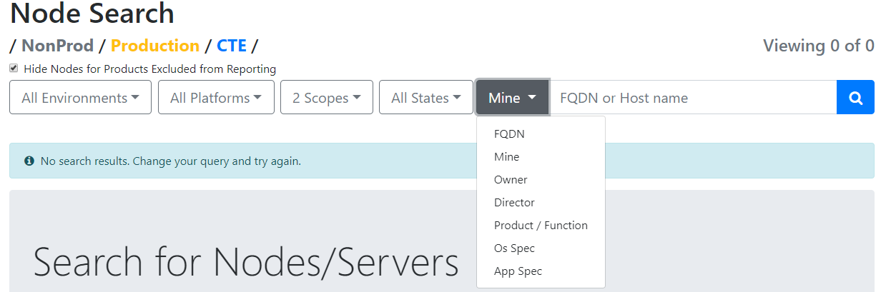
Node Search
This screen provides a way to easily search for nodes and assign various Application Specs to various nodes
Search options include:

Slide 43
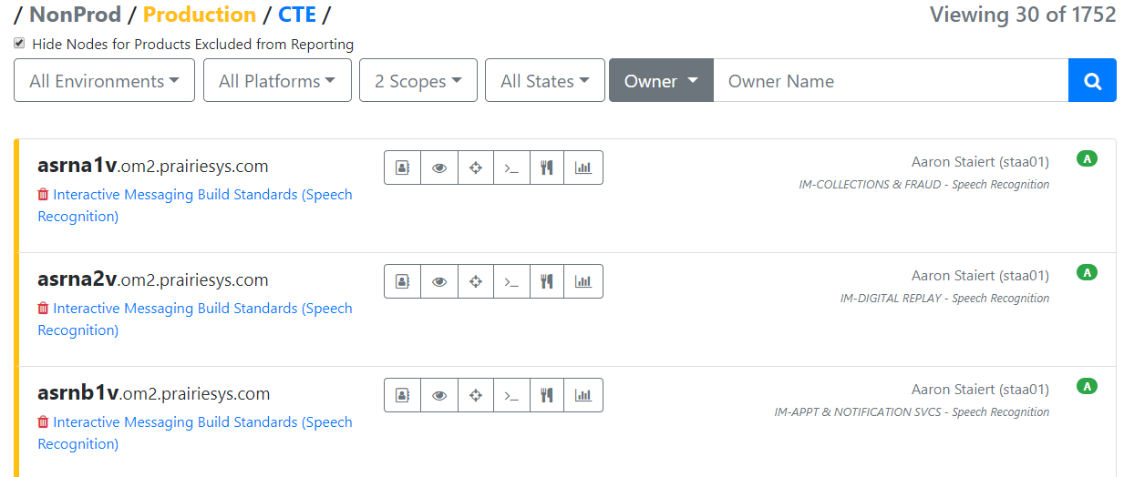

Node Search
Search results will display a color coded side bar
Below each node, the assigned Application Spec is listed
If none is listed, simply click on the link and start typing the name of the spec. Once 3 characters have been entered, a list will appear that match those characters.

Slide 44






Node Search
Search results display with an option to:
View in Asset Inventory System – opens your Inventory System to the specific node
View Report – displays the Build Spec Report
Review Compliance – displays the aggregate Chef results
View Port Report – displays the Port information
View Chef Converge – launches Chef Automate with a view of the steps completed
View Compliance Report – launches Chef Automate with the results for the specific node
Notes:
Remove extra period

Slide 45


Chef Compliance Report
Chef Compliance is used to measure the information entered for the Application Specification and the assigned Nodes to report adherence to those specs. The Chef data will be automatically updated every 30 minutes.
The Compliance button launches Chef Automate and displays the reporting information for the specific node.
Records with a indicate the test passed whereas indicates a failure. Click on the record to drill down to additional information specific to that node. Icons for passed tests and failures will display for each record. To expand the details of that control, click on the at the end of the row. Likewise, to close the details, click on the at the end of the expanded row.

Slide 46
Email Notifications

Slide 47
Email Notifications
ACT will send the following email notifications:
Unassigned Nodes
Compliance Failures
Nodes that are Not Reporting
Emails will be sent to the following resources:
Node Owner
Application Spec Owner
Application Spec Optional email address as listed in the App Spec
OS Spec Owner
OS Spec Optional email address as listed in the OS Spec

Slide 48
Unassigned Nodes Email Notification
If a Node has not been assigned to an Application Spec, the Node Owner for that server will receive the following email notification:
From: enterprisereporting@csgi.com Sent: Date To: Node Owner
Subject: Unassigned Nodes in ACT
Node Owner Name, you are receiving this email because you are the identified owner of node name and this server is not assigned to an Application specification within ACT. Please assign this server to an Application Specification to resolve this email alert.
Thank you, PCI DevOps Remediation Team
This process runs once a day around mid-night every night

Slide 49
Compliance Failure Email Notification
f t fails then its triggered, by default chef runs every 30 minutes
If a Node does not completely match the Application and associated OS Spec, the Node Owner, App Spec Owner (and optional email address if specified) and OS Spec Owner (and optional email address if specified) will receive the following email notification:
From: enterprisereporting@csgi.com Sent: Date To: Node Owner, App Spec Owner (and optional email address if specified) and OS Spec Owner (and optional email address if specified)
Subject: ACT Compliance Failure for a PCI ‘A’ or ‘B’ class system – NODE NAME
Node Owner Name, you are receiving this email because you are the identified owner of node name and this server has failed the ACT Compliance checks. The link to the Compliance Review screen can be accessed via {link to the Compliance Review screen for this server}.
NOTE: to ensure the Compliance Review screen has current data, please remember to refresh the data by clicking on the Seed button for the specific environment.
Please update your spec(s) or remediate the issue on the server.
Thank you, PCI DevOps Remediation Team
This is kicked off by a Chef run on a node, if it fails then it’s triggered; by default Chef runs every 30 minutes

Slide 50
Nodes Not Reporting Email Notification
If a Node status is set to Not Reporting for Class A or B servers, the Node Owner, App Spec Owner (and optional email address if specified) and OS Spec Owner (and optional email address if specified) will receive the following email notification:
From: enterprisereporting@csgi.com Sent: Date To: Node Owner, App Spec Owner (and optional email address if specified) and OS Spec Owner (and optional email address if specified)
Subject: ACT Not Reporting Failure for a PCI XX class system – NODE NAME
Node Owner Name, you are receiving this email because you are the identified owner of node name or its Application or OS specification and this server has not reported to Chef within 48 hours. Please ensure the node is still running the chef-client to resolve this email alert.
Thank you,
PCI DevOps Remediation Team
This process runs once a day

Slide 51
Reporting

Slide 52
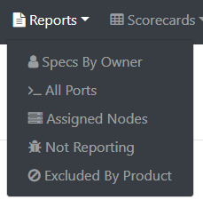
Navigating in ACT
Reports options include:
Specs By Owner
All Ports
Assigned Nodes
Not Reporting
Excluded by Product

Slide 53
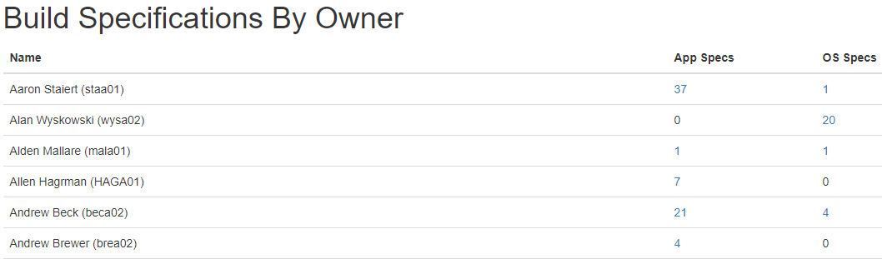
Specs By Owner
Specs By Owner report summarizes the count of Specifications by Application and Operating System
The Node Count is a link to display the Results (names of the Specifications)

Slide 54
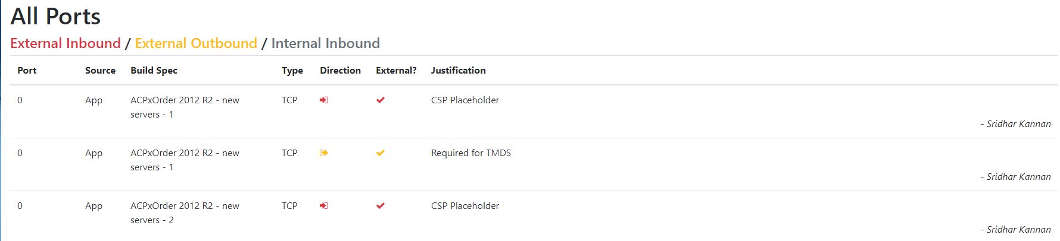
All Ports
The All Ports report displays all of the Port information from the Application and Operating System specs
The data is color coded to identify the direction of the port

Slide 55
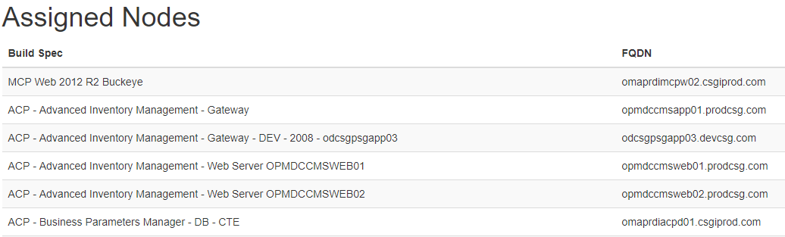
Assigned Nodes
The Assigned Nodes report displays all of the Nodes and the Application spec it is assigned to

Slide 56
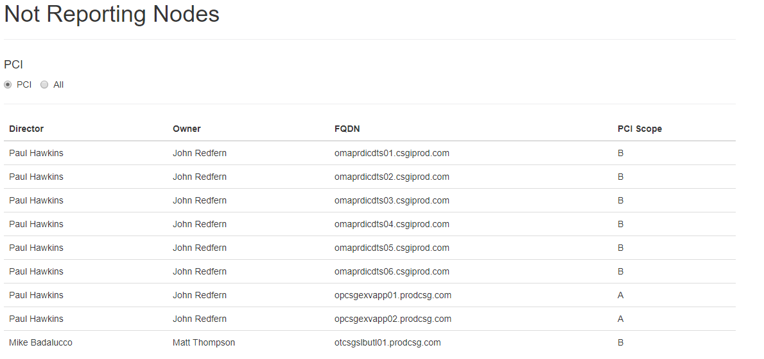
Not Reporting Nodes
The Not Reporting Nodes report displays the Director, Owner and Node
Users can select if they want to see only Class A/B Nodes in PCI Scope or All Classes

Slide 57
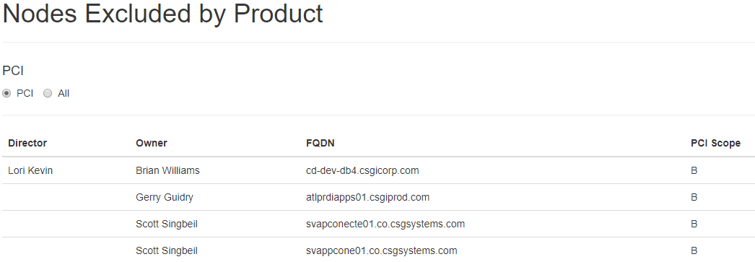
Nodes Excluded by Product
The Nodes Excluded by Product report displays the Nodes that have been specifically excluded from the Reporting options on the Dashboard
Users can select if they want to see only Class A/B Nodes in PCI Scope or All Classes

Slide 58
Scorecards

Slide 59
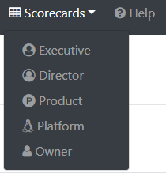
Scorecards
Scorecard options include:
Executive
Director
Product
Platform
Owner

Slide 60
Executive Scorecard
The Executive Scorecard summarizes data and allows the user to progress up the management chain or search for a specific employee’s reporting results
The default view will be based on the current user
Users can select if they want to see only Class A/B PCI data or All Classes
The results can be exported to Excel
By clicking on the Spec Owner name, the Owner Scorecard will display
By clicking on the count in the Direct Reports column, it will launch the Executive Scorecard for that Spec Owner

Slide 61
Executive Scorecard
Field definitions
Spec Owner – the employee listed as the owner for the spec
Specs – number of specifications for a given owner
Assigned Nodes – number of nodes assigned to a specification
Passing Nodes – number of nodes passing the compliance tests
Failing Nodes – number of nodes failing the compliance tests
Not Reporting – number of nodes that are not reporting Chef data
Out of Scope – number of nodes identified as being out of scope, this includes appliances, specific product groups, mainframe servers and specific server vendors (SUN, IBM, HP)
Asset Inventory System Total Nodes – number of nodes identified in Asset Inventory System for the Spec Owner
Direct Reports – number of employees reporting to the Spec Owner

Slide 62
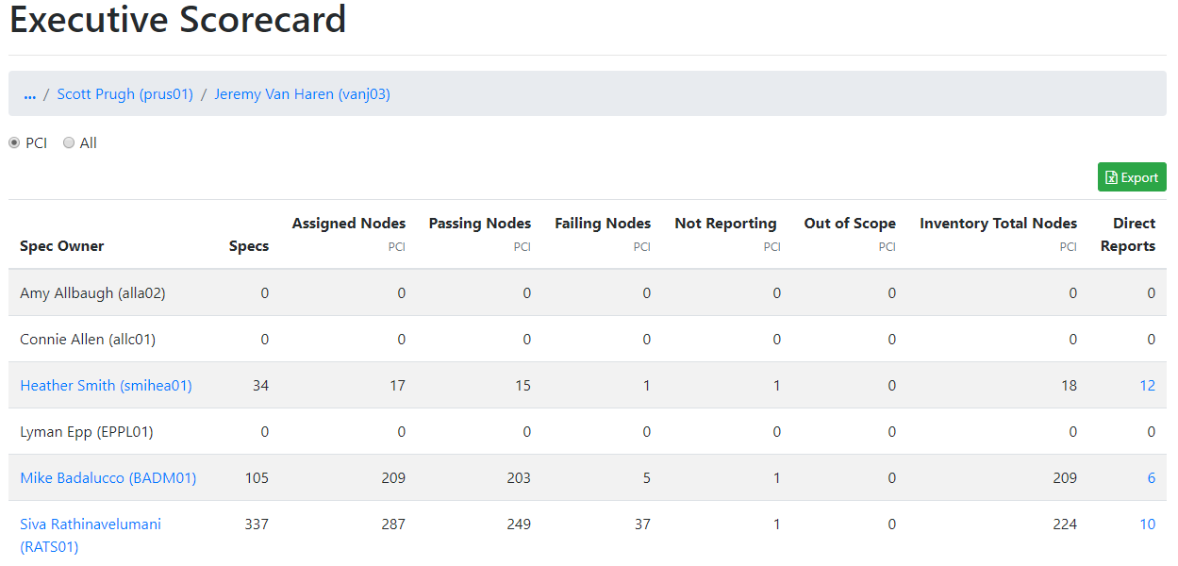
Executive Scorecard

Slide 63
Director Scorecard
The Director Scorecard summarizes data at the Director level
Users can filter the data to display PCI data (Class A/B) or All Classes
Additional filters include viewing reporting based on a status of Unassigned, Not Reporting or Failing
The results can be exported to Excel

Slide 64
Director Scorecard
Field definitions
Director – the Director of the Owner
Owner – the employee listed as the owner for the spec
Specs – number of specifications for a given owner
Assigned Nodes – number of nodes assigned to a specification
Passing Nodes – number of nodes passing the compliance tests
Failing Nodes – number of nodes failing the compliance tests
Not Reporting – number of nodes that are not reporting Chef data
Out of Scope – number of nodes identified as being out of scope, this includes appliances, specific product groups, mainframe servers and specific server vendors (SUN, IBM, HP)
Total Nodes – number of nodes identified in Asset Inventory System for the Spec Owner

Slide 65
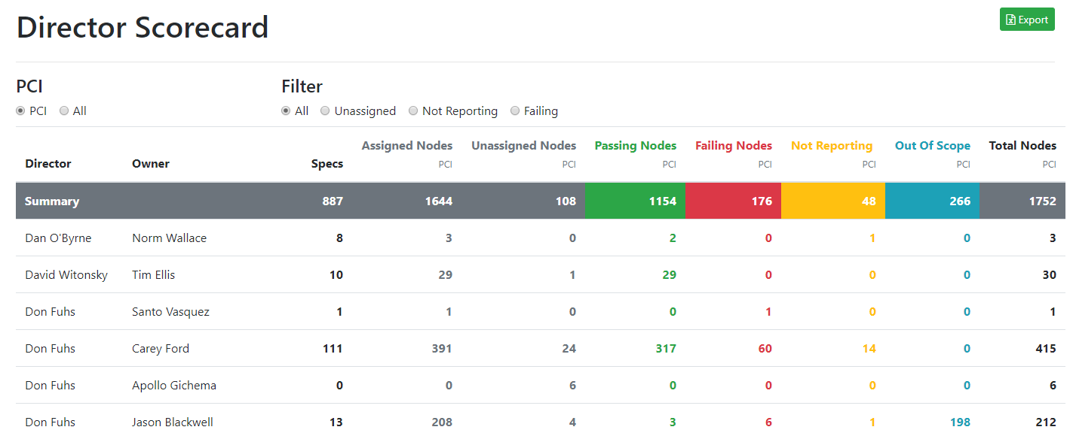
Director Scorecard

Slide 66
Product Scorecard
The Product Scorecard summarizes data at the Product and Function level
Users can filter the data to display PCI data (Class A/B) or All Classes
Additional filters include viewing reporting based on a status of Unassigned, Not Reporting or Failing
The results can be exported to Excel

Slide 67
Product Scorecard
Field definitions
Product – Product assigned in Asset Inventory System
Function – Function assigned in Asset Inventory System
Director – the Director of the Owner
Owner – the employee listed as the owner for the spec
Specs – number of specifications for a given owner
Assigned Nodes – number of nodes assigned to a specification
Unassigned Nodes - number of nodes not assigned to a specification
Passing Nodes – number of nodes passing the compliance tests
Failing Nodes – number of nodes failing the compliance tests
Not Reporting – number of nodes that are not reporting Chef data
Out of Scope – number of nodes identified as being out of scope, this includes appliances, specific product groups, mainframe servers and specific server vendors (SUN, IBM, HP)
Total Nodes – number of nodes identified in Asset Inventory System for the Spec Owner

Slide 68
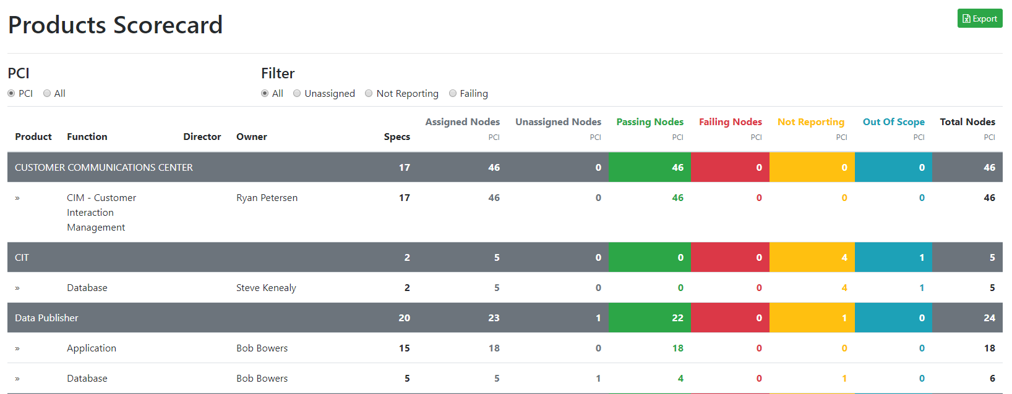
Product Scorecard

Slide 69
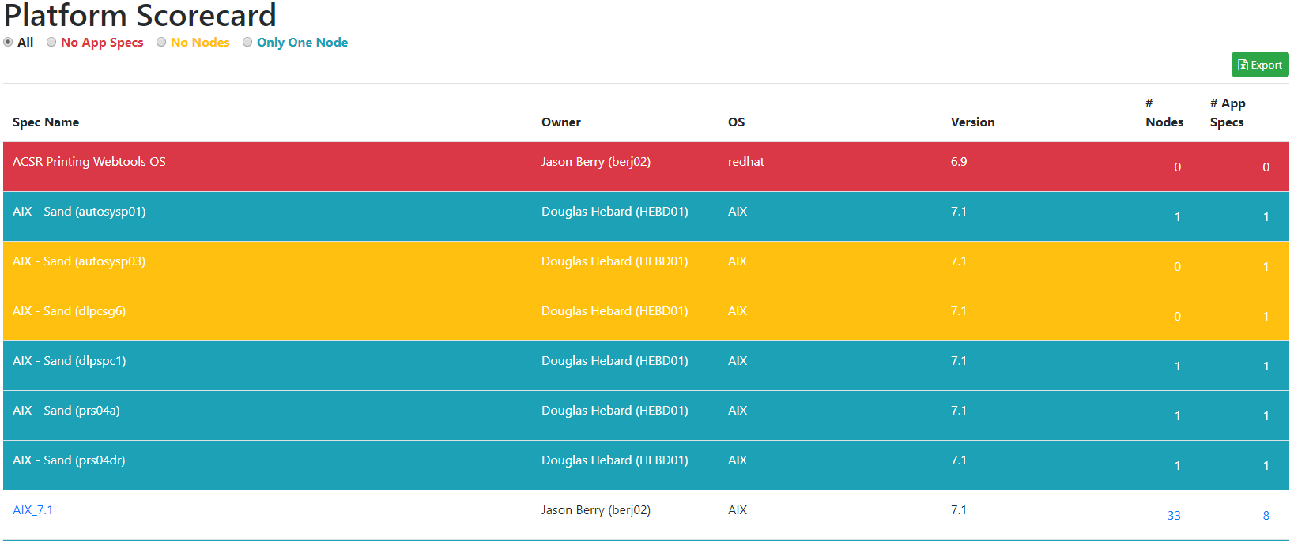
Platform Scorecard
The Platform Scorecard displays data for the Operating System Specifications
Filters to easily identify conditions
The results can be exported to Excel

Slide 70
Platform Scorecard
Field definitions
Spec Name – Name of the OS Spec
Owner – the employee listed as the owner for the spec
OS – name of the Operating System entered on the OS Spec
Version – version number of the Operating System entered on the OS Spec
# Nodes – number of nodes assigned to a specification
# App Specs – number of App Specs using the specific OS Spec

Slide 71
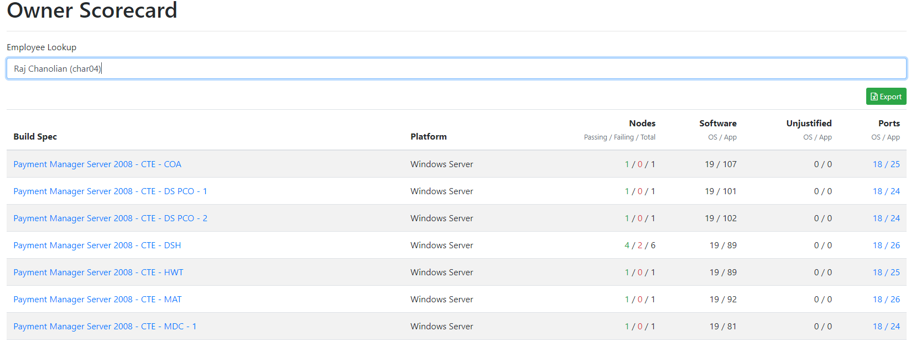
Owner Scorecard
The Owner Scorecard displays data for the Application Specifications for a given Owner
Users can search for an Employee by name
The results can be exported to Excel

Slide 72
Owner Scorecard
Field definitions
Build Spec – Name of the Application Spec
Platform – name of the Platform System entered on the OS Spec
Nodes
Passing – number of nodes passing the compliance tests
Failing – number of nodes failing the compliance tests
Total – Passing + Failing
Software
OS – number of Linux Packages or Windows Features & Applications entered in the OS Spec associated to the App Spec
App – number of Linux Packages or Windows Features & Applications entered in the App Spec
Unjustified
OS – number of Linux Packages or Windows Features & Applications entered in the OS Spec associated to the App Spec that do not have a justification assigned
App – number of Linux Packages or Windows Features & Applications entered in the App Spec that do not have a justification assigned
Ports
OS – number of Ports entered in the OS Spec associated to the App Spec
App – number of Ports entered in the App Spec

Slide 73
Thank You!

